Slide 1

Money Tree
Website for Finance and Budget Tracking
CS590 Web Development Project
By:
Aakriti Deora
Pragna Mallikarjuna Swamy
Ved Pawar

Slide 2
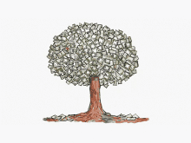
What is Money Tree?
Website to keep track of income- expenses and helps in budgeting.
Provides individual with their personalized accounts and enables the pictorial representation of their expenses.
No need of maintaining expenses with paid applications.
Provides ease of use to update the transactions at regular intervals

Slide 3
Sprint 1
Mockups of webpages – wireframe
Screenshots
Database Schema
API

Slide 4
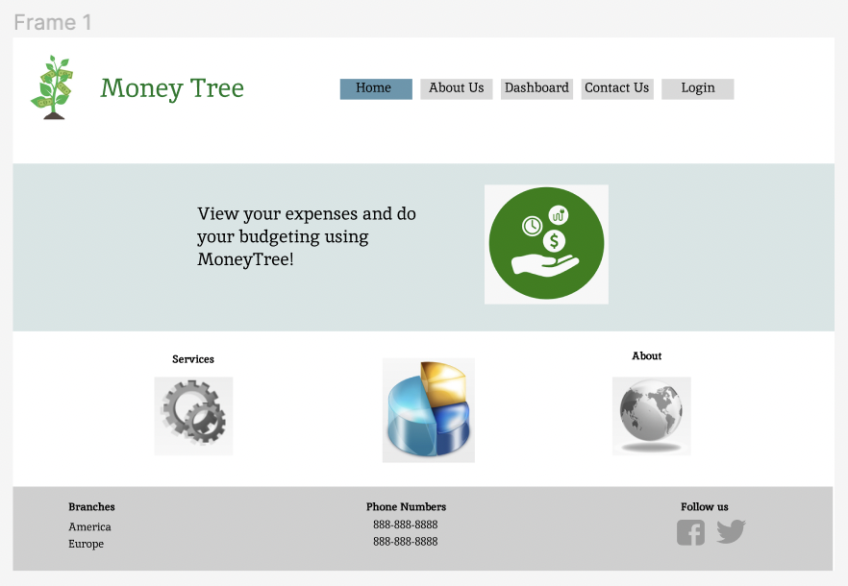
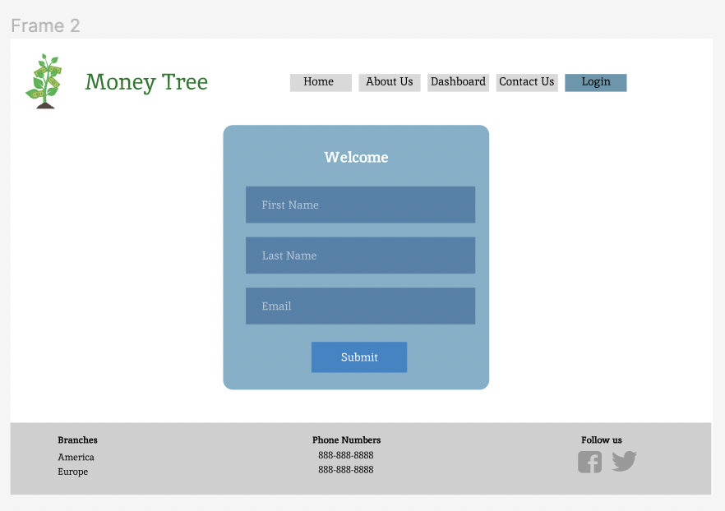
Sprint1- Wireframes
Home Page
Login Page

Slide 5
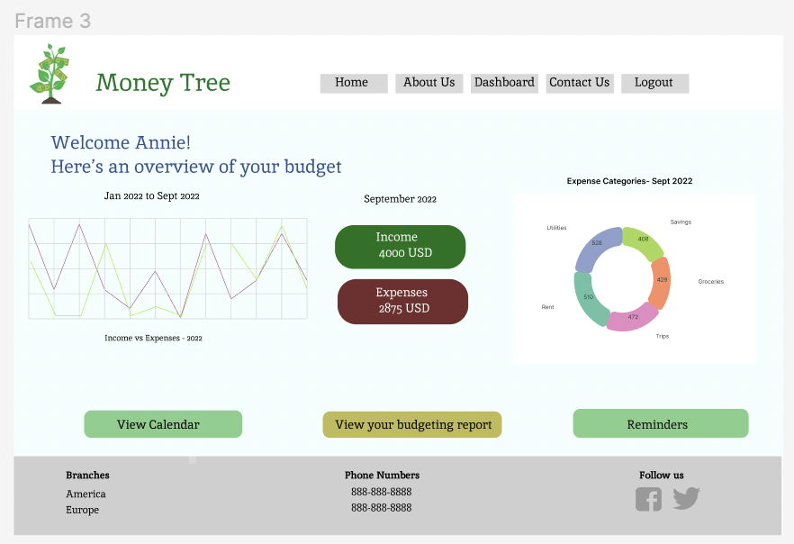
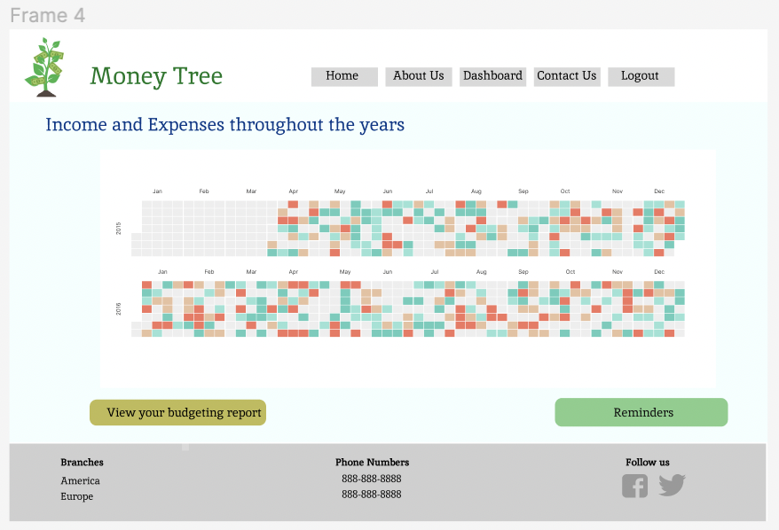
Sprint1- Wireframes
User Dashboard Page
Calendar Page

Slide 6
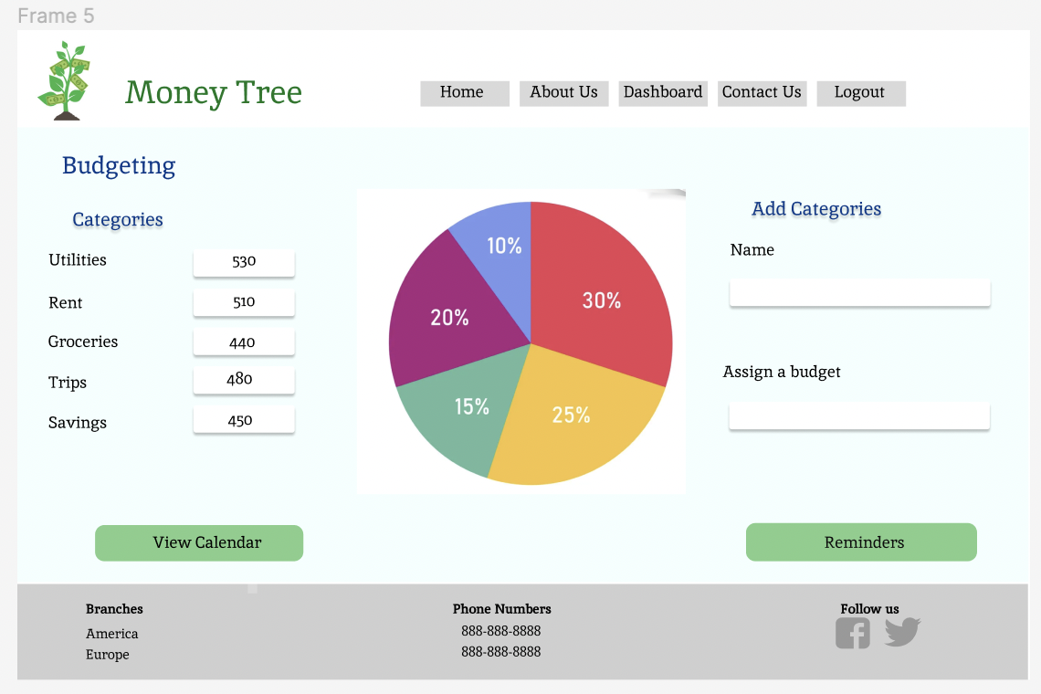
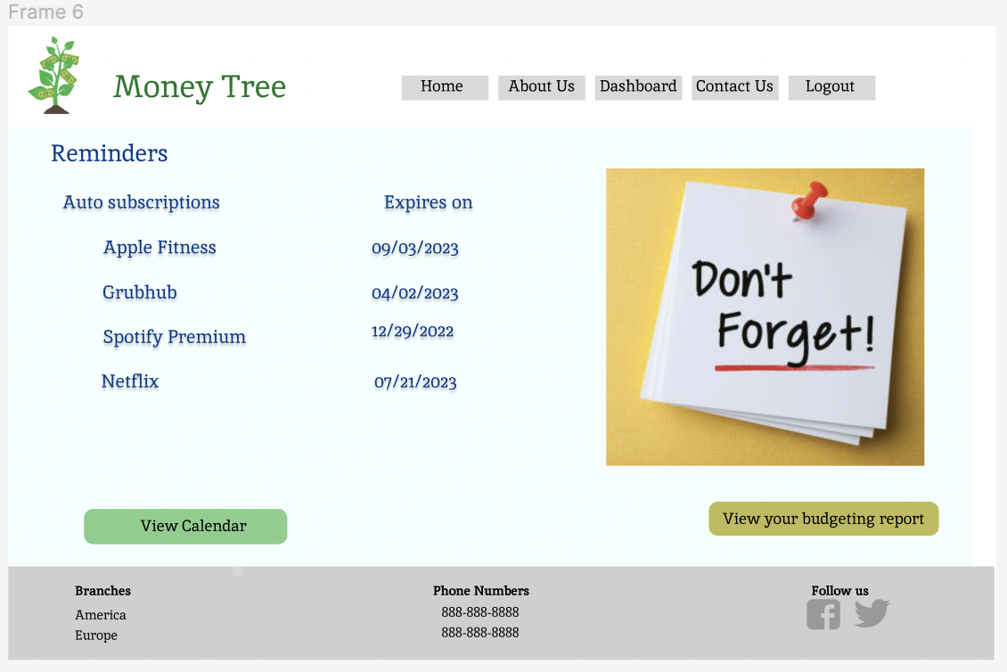
Sprint1- Wireframes
Budgeting Page
Reminders Page

Slide 7
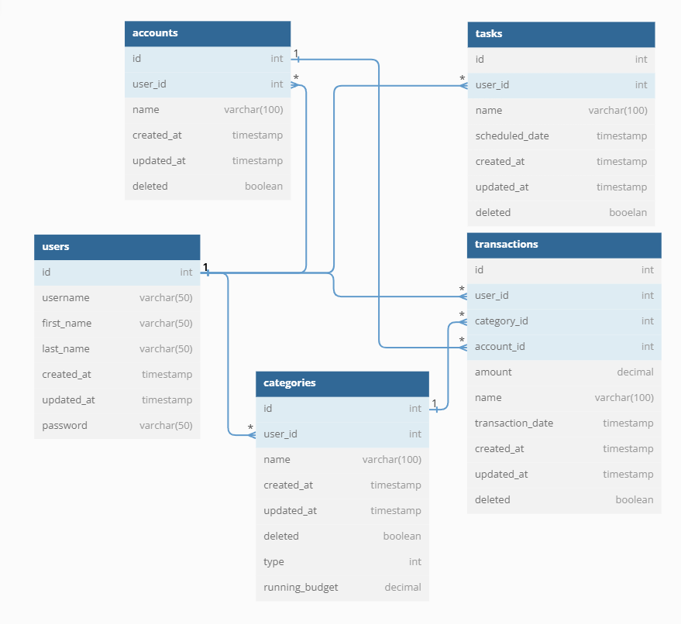
Database Design

Slide 8
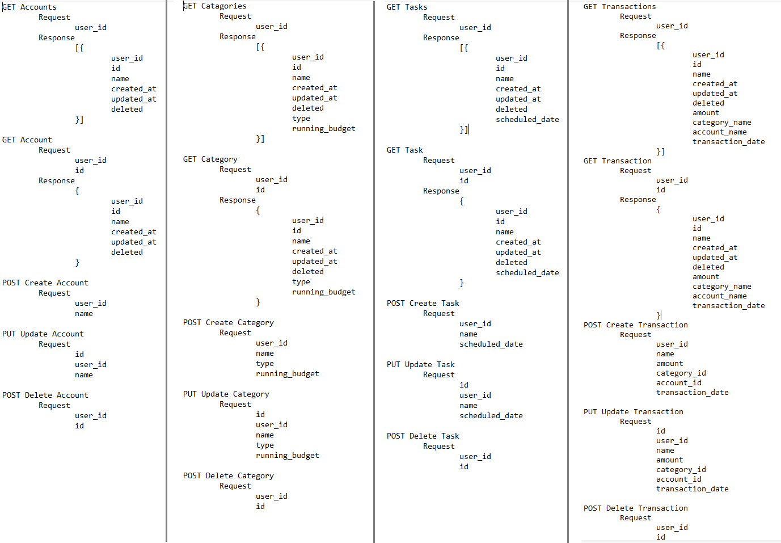
Initial API

Slide 9
Sprint 2
Homepage
Login page
React application
Finalized Database schema

Slide 10
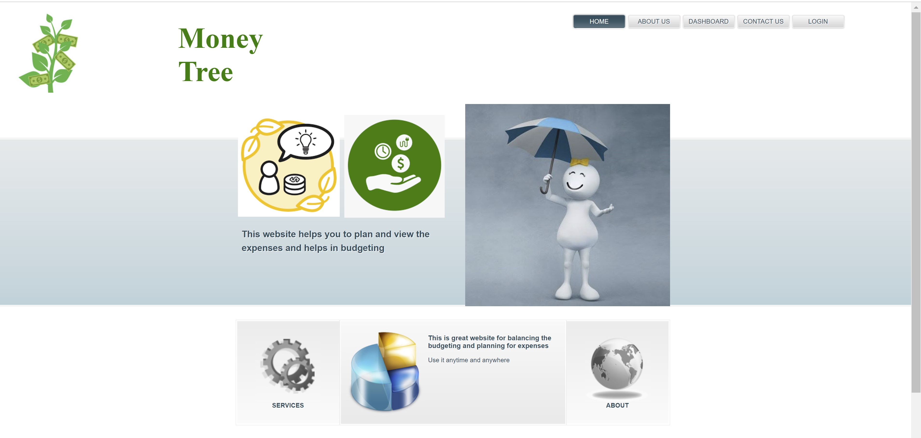
Homepage

Slide 11
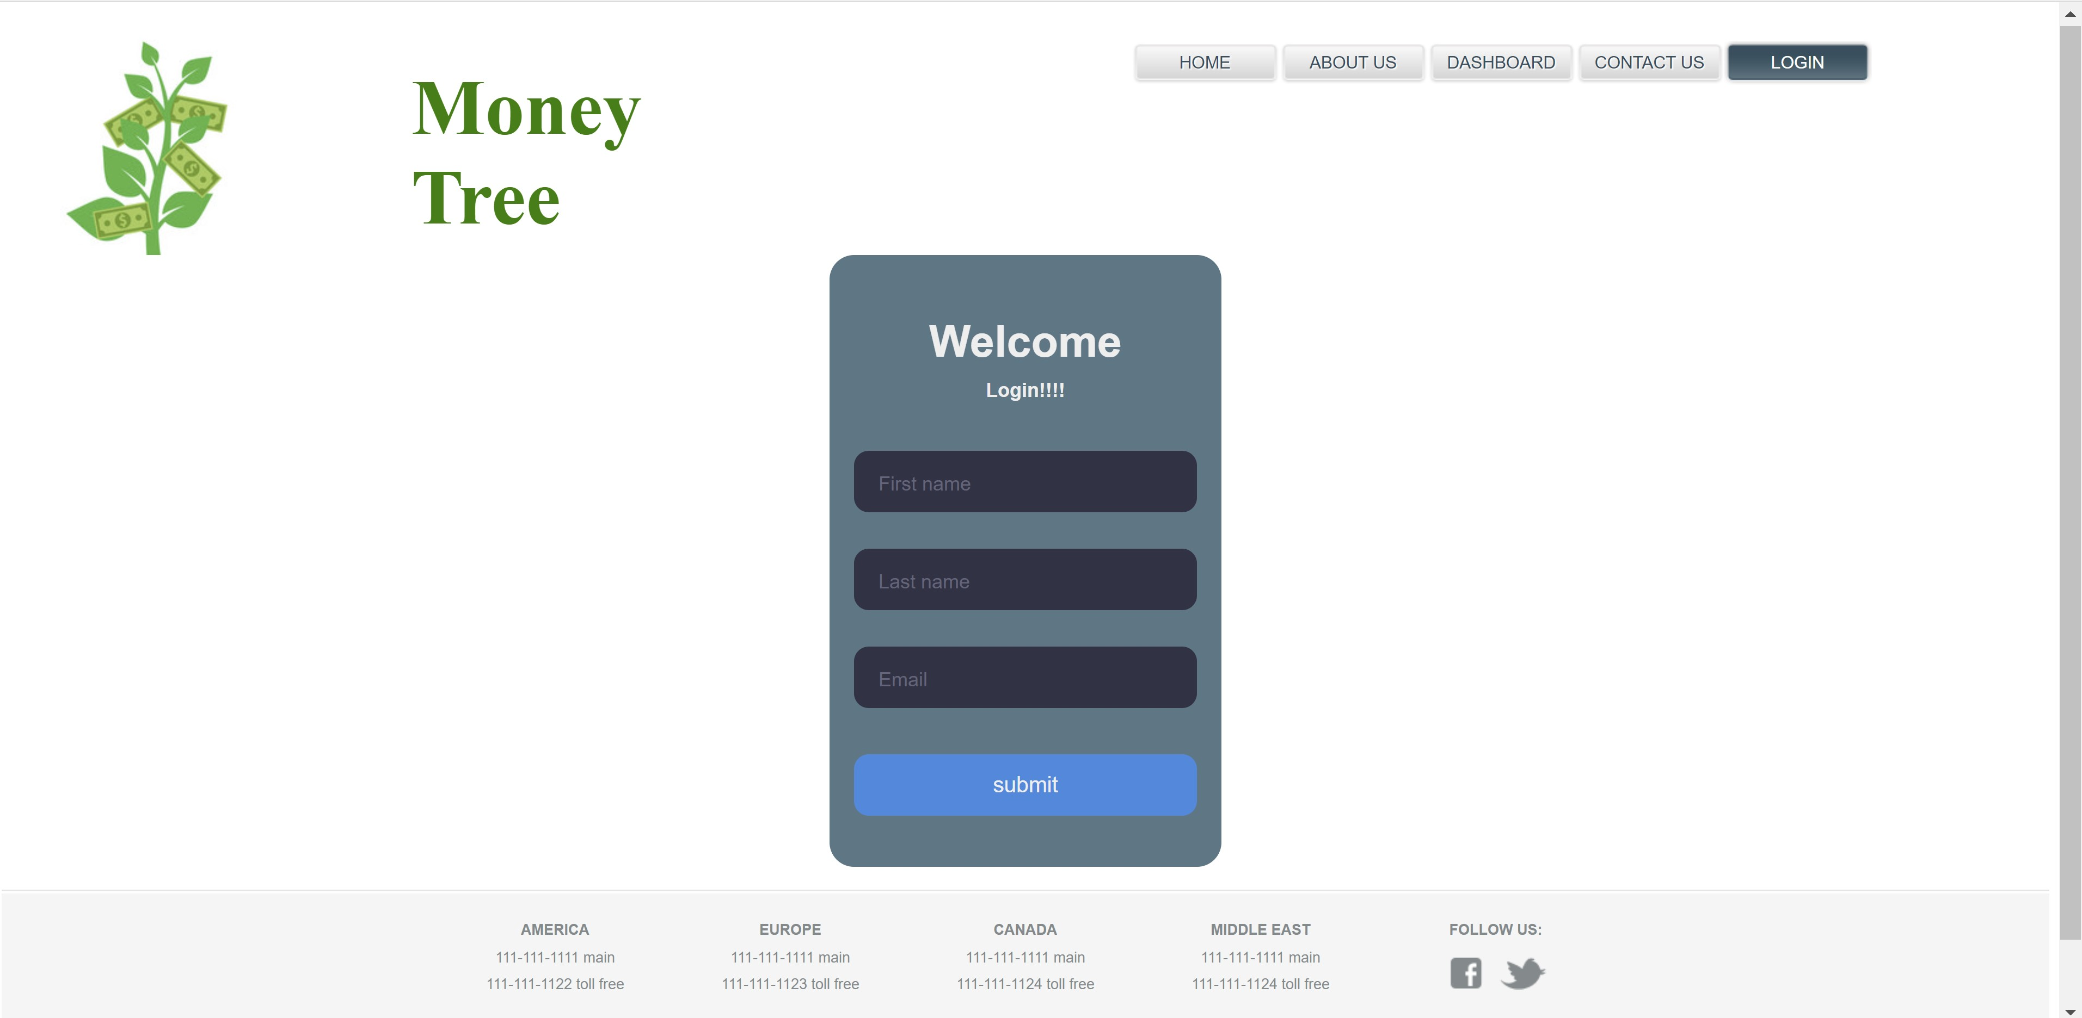
Login page

Slide 12
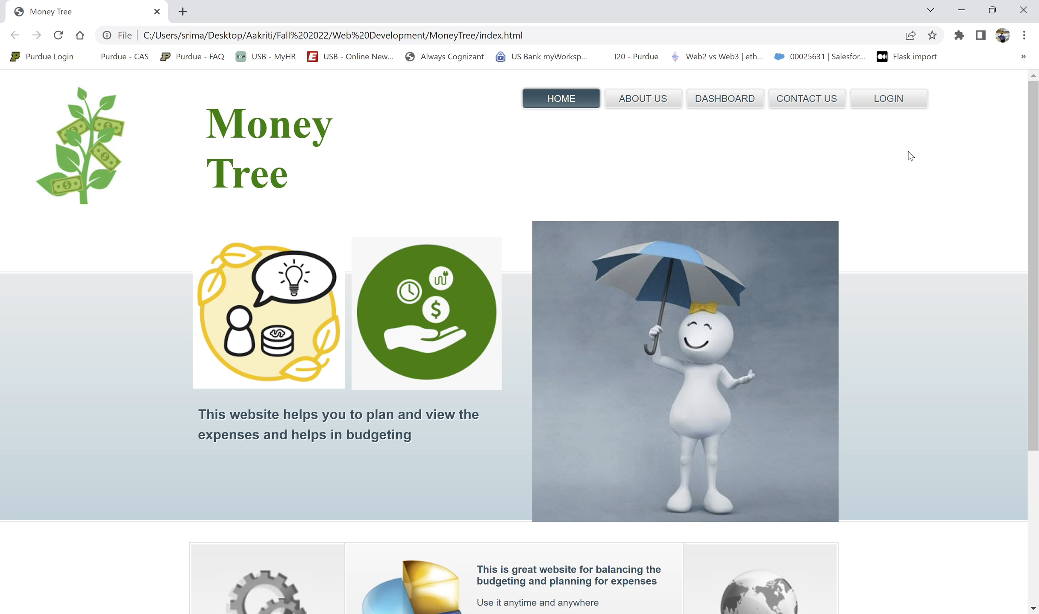
Recording

Slide 13
Upcoming Tasks
Tweak UI designs as and when needed to improve user experience and usability.
Revisit database design to accommodate any future changes for data consistency.
Update APIs to reduce any unnecessary calls made.
Complete the future Sprints.

Slide 14


